Slide 1



[insert your location]
This work is licensed under a Creative Commons Attribution-NonCommercial-ShareAlike 4.0 International License
Complied by

Slide 2
Purpose of the NGOCS living document
The document exists of two parts
The Next Generation of Cultural Spaces network tells the narrative of the NGOCS project, who is part of it and what it aims to accomplish.
The Next Generation of Cultural Spaces in [insert your location] provides an template that allows you to tell the story of your space or concept, framed within the narrative of the NGOCS project.
We aim for you to modify this document to your needs. It can be used to present your space or concept to the outside world, especially to local administrators, property owners or potential funders.
As a living document, it is to be regularly edited, updated and expanded with new information and templates. The goal is to provide an increasingly effective tool that can strengthen existing spaces and support obtaining new spaces for independent non-dominant culture.
This living document is made for cultural collectives in Southern and Eastern Europe that have an own independent space or aim to obtain an independent space for non-dominant culture.

Slide 3
PART 1
The Next Generation of
Cultural Spaces network

Slide 4
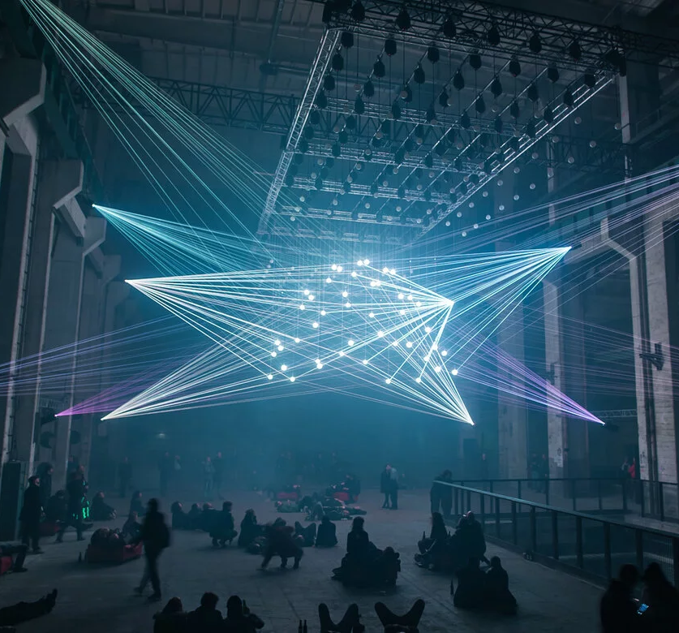

The Next Generation of Cultural Spaces is a transnational alliance
that reimagines the use of historical spaces,
reviving them through cultural activities to create safe spaces
for non-dominant culture and marginalised groups
in Eastern & Southern Europe.

Slide 5





The Next Generation of Cultural Spaces network
Who are the members of the network?
The Next Generation of Cultural Spaces is a transnational alliance set up by
Independent cultural collectives and spaces
Cultural institutes
NGOs
Academics
Politicians and administrators
Property owners
It is supported by
100+
5
29
The network exists of
members
continents
countries

Slide 6

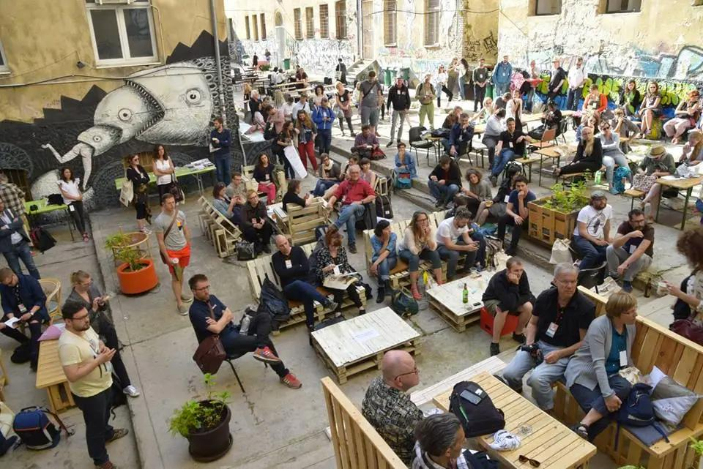
Aims of the Next Generation of Cultural Spaces
The Next Generation of Cultural Spaces has 3 aims
1
2
3
Bring together a translocal network of Southern & Eastern European initiatives and spaces for non-dominant culture, changemakers, advocates, academics, institutions and local governments
Create a direct local impact for the independent cultural ecosystems in Southern & Eastern Europe
Document the processes so that it can be developed into a bigger, thriving network that supports the development of the next generation of cultural spaces

Slide 7
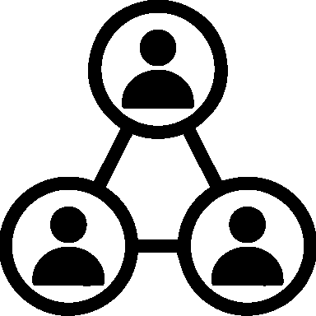





What are the Next Generation of Cultural Spaces?
The five characteristics of NGOCS’ are
Stakeholders
Business Model
Legal Structure
Social & cultural impact beyond borders of space
Transnational alliance
Active participation within the local creative and cultural ecosystem
Multifaceted model with 3-4 income streams, with both nonprofit and for-profit elements
Charitable or nonprofit organization, having ownership over the space for min. 25 years.
Embedded in the local cultural context, operated for the benefit of the local community
Tied to a strong transnational alliance
Individual NGOCS’ will greatly differ depending on their geographic location, socio-cultural and political surroundings and needs
Local context

Slide 8
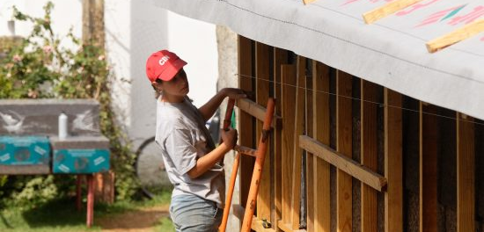
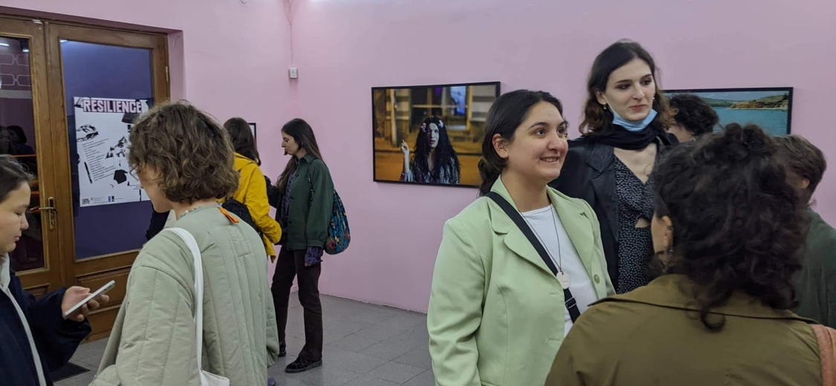
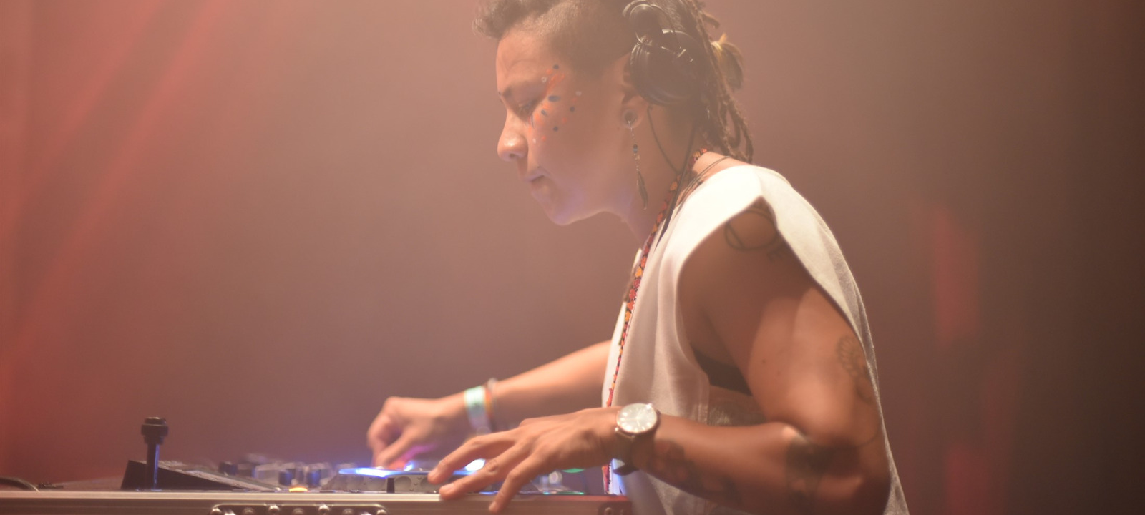
Why do we need the Next Generation of Cultural Spaces?
NGOCS’ represent a long-term holistic perspective on planning and investing, mixing culture with the economic and social life.
They align with the global trends of looking beyond short-term monetary value and motivating self-organization by citizens.
NGOCS’ create economical, social, cultural and ecological value by:
Offering communal space for local communities
Creating employment
Professionalization of the creative ecosystem
Facilitating social, ecological and technological innovation
Reducing outflux of creative professionals and educated young people
Building international connections, placing the region in an international focus
Many cities and regions in Southern and Eastern Europe contain underused historical buildings. We see these buildings as ideal places for hosting the Next Generation of Culture. Why?
Symbolic - linking the historical past to a new and inclusive future
Practical - buildings are maintained and renovated by the creative community

Slide 9
PART 2
The Next Generation of Cultural Spaces in
[insert location]

Slide 10

The Next Generation of Cultural Spaces in [insert location]
[Insert name of your NGOCS]
Vision & visualization
Stakeholders
Business Model
Legal Structure
Impact

Slide 11
Vision and Visualization
Create a graphic visualisation of your space!
  3D Visualizations of the building (inside and outside) showing cultural activities and target groups
  2D Floorplan showing the spaces and functions
[Insert] your vision here (50 -100 words)
Use the NGOCS Narrative to enhance your concept

Slide 12
The path adopted by the NGOCS project is promising. It is based on a powerful shared narrative carried by a broad international alliance, resulting in local changemaking processes. The consortium is confident that adhering to the project philosophy will lead to tangible results
Stakeholder Engagement
Environment
Local Communities
Local Economy
[Insert your target groups!]
(local social and cultural communities)
[Insert partners from you local economic environment!]
(for example: other spaces, cultural institutes, interest groups, companies, municipal departments)
International Partners
Businesses/loceconomy
[Insert your international partnerships!]
(The NGOCS network, etc…)

Slide 13

Business Model
[insert] Describe the main activities of the NGOCS
Name the income streams that you plan to establish (3-4 different streams, for example; local and international grants, ticket and bar sales, space rental, corporate events, memberships, private investment)
Describe the for-profit & nonprofit elements of the NGOCS (e.g. how do you use for-profit activities to support nonprofit activities?)

Slide 14
Legal structure
[insert] Legal entity & organization
  What is the legal form behind the NGOCS?
  What is the goal of this entity?
  Who is in the organizational team?
Ownership model
  How do you envision the ownership model of the NGOCS to look like? (ideally you should either be the owner of the building or have a long-term term management contract that gives you decision making power)

Slide 15
Impact
[insert] What are social, cultural economic and cultural needs in the environment of your space?
How will your NGOCS meet these needs?
What will be the long-term impacts of this on the environment? (think about economic, social, cultural and ecological impacts)
How does the NGOCS enhance the existing cultural ambitions of the (local) government?

Slide 16
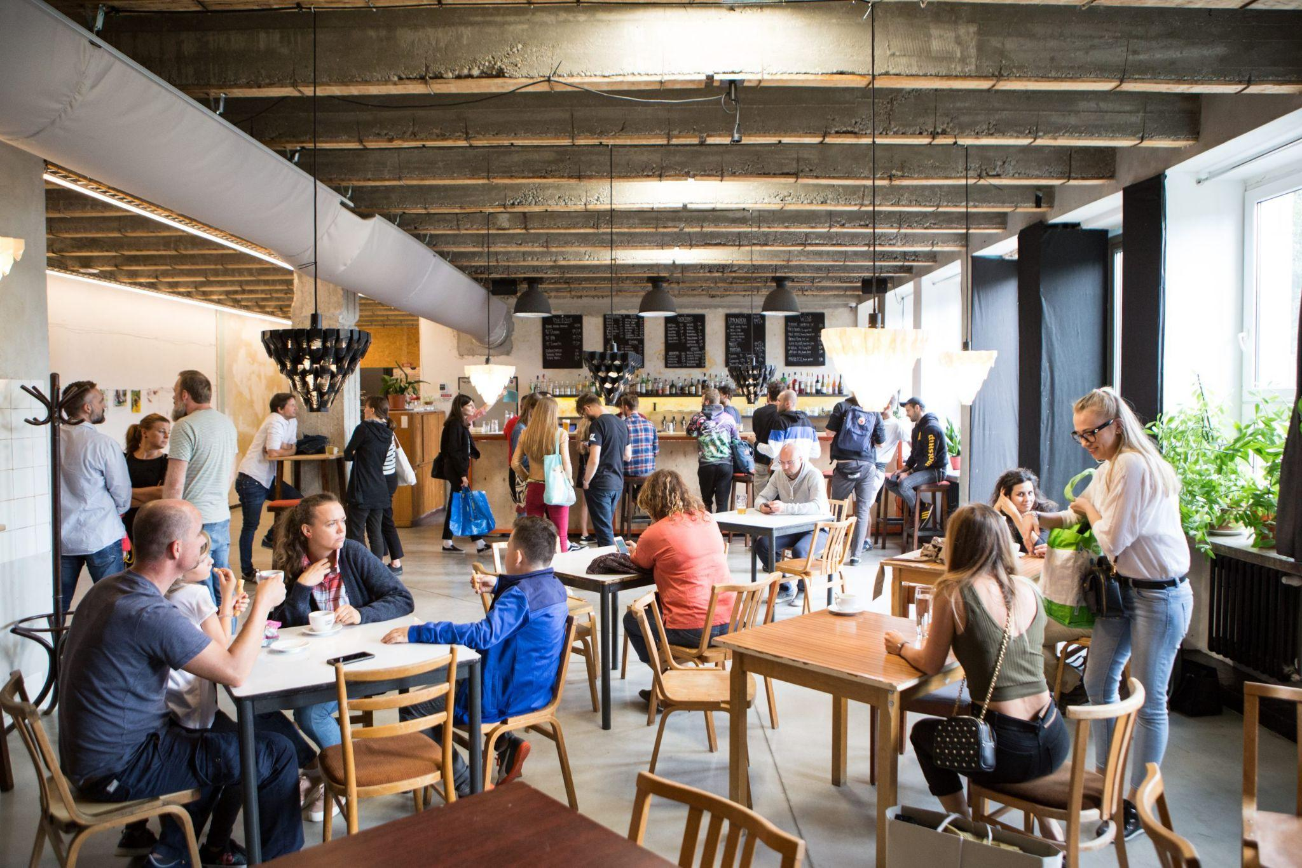
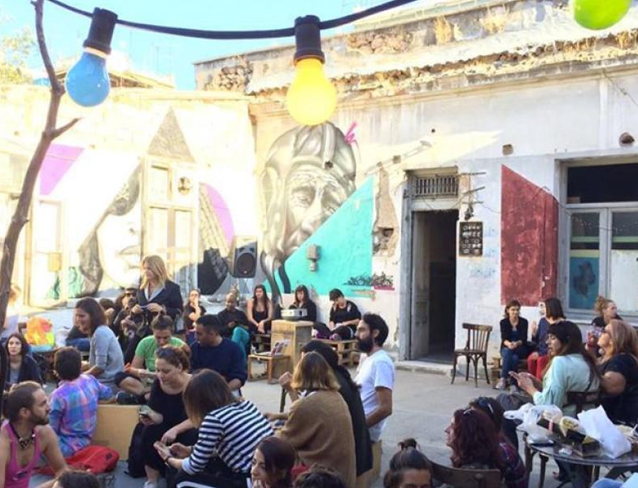

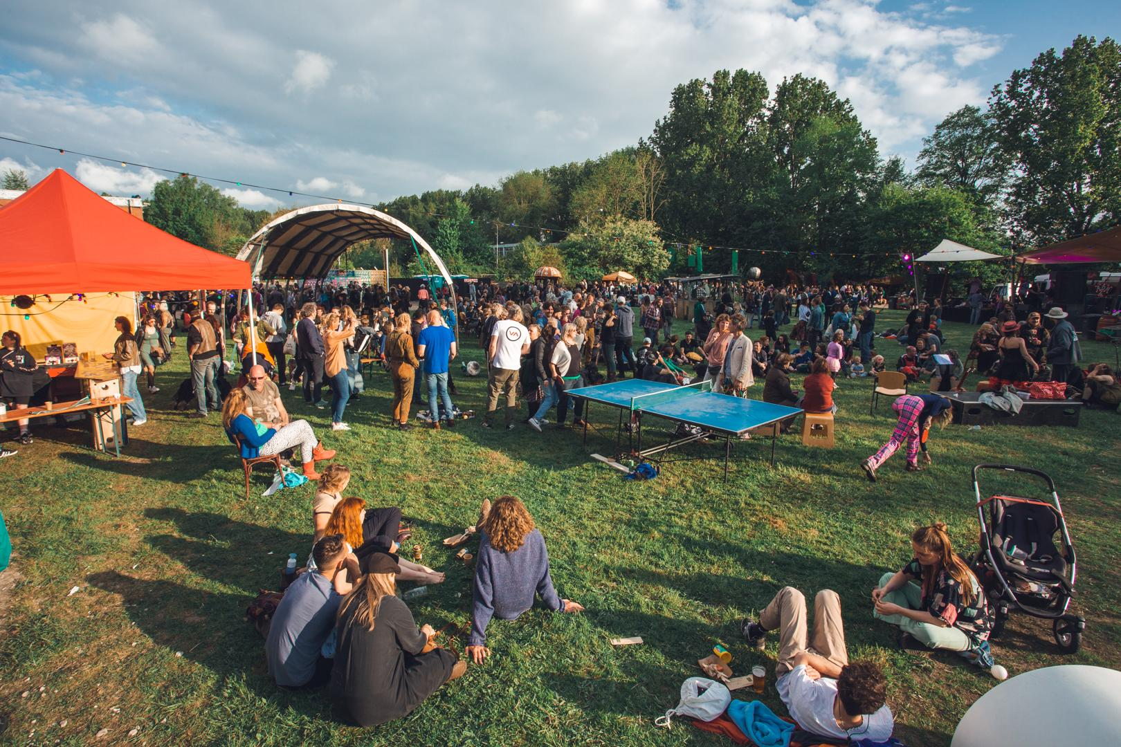
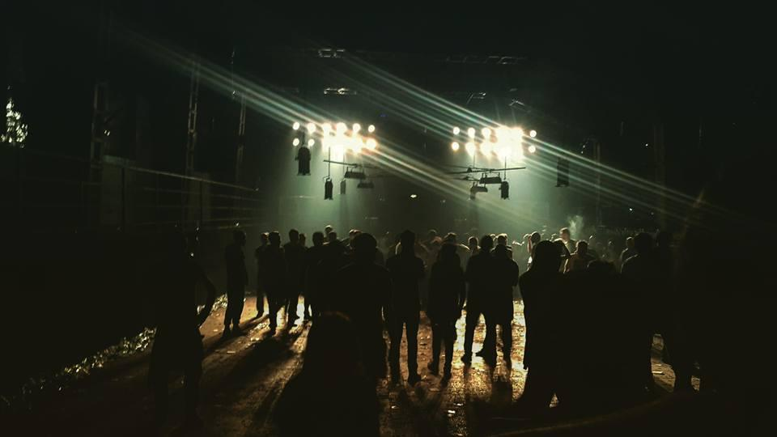
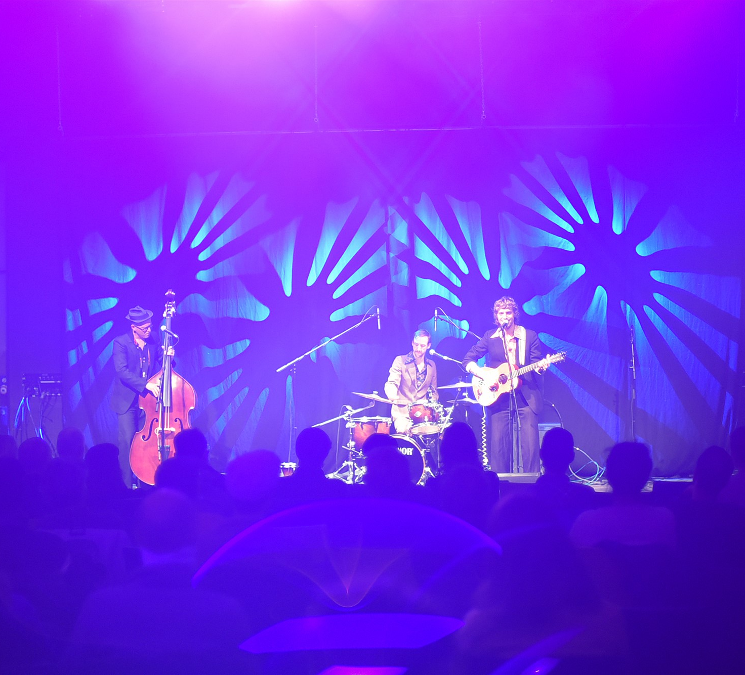
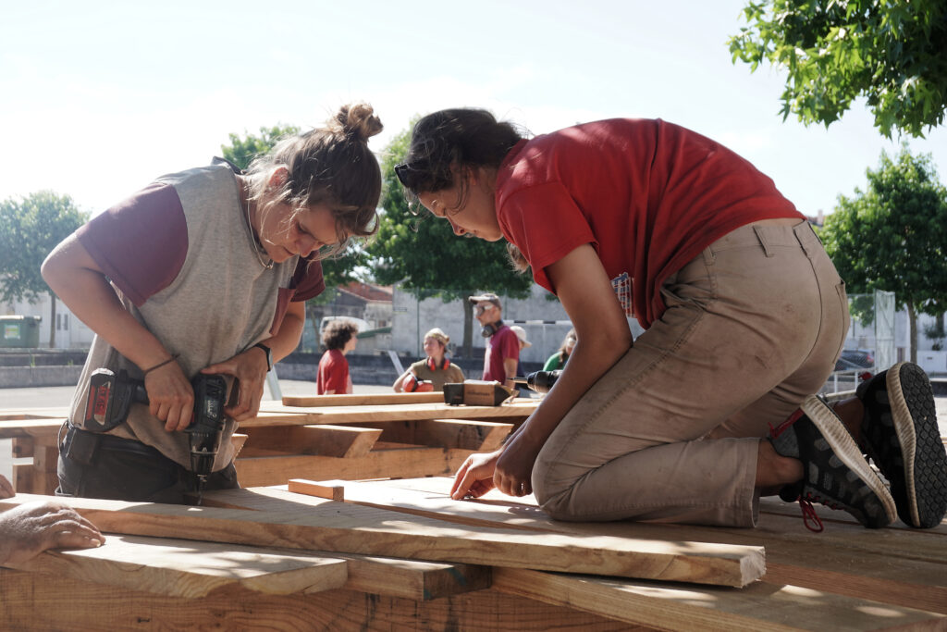
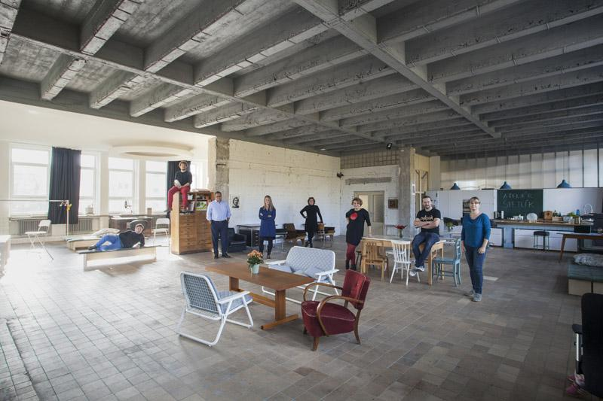
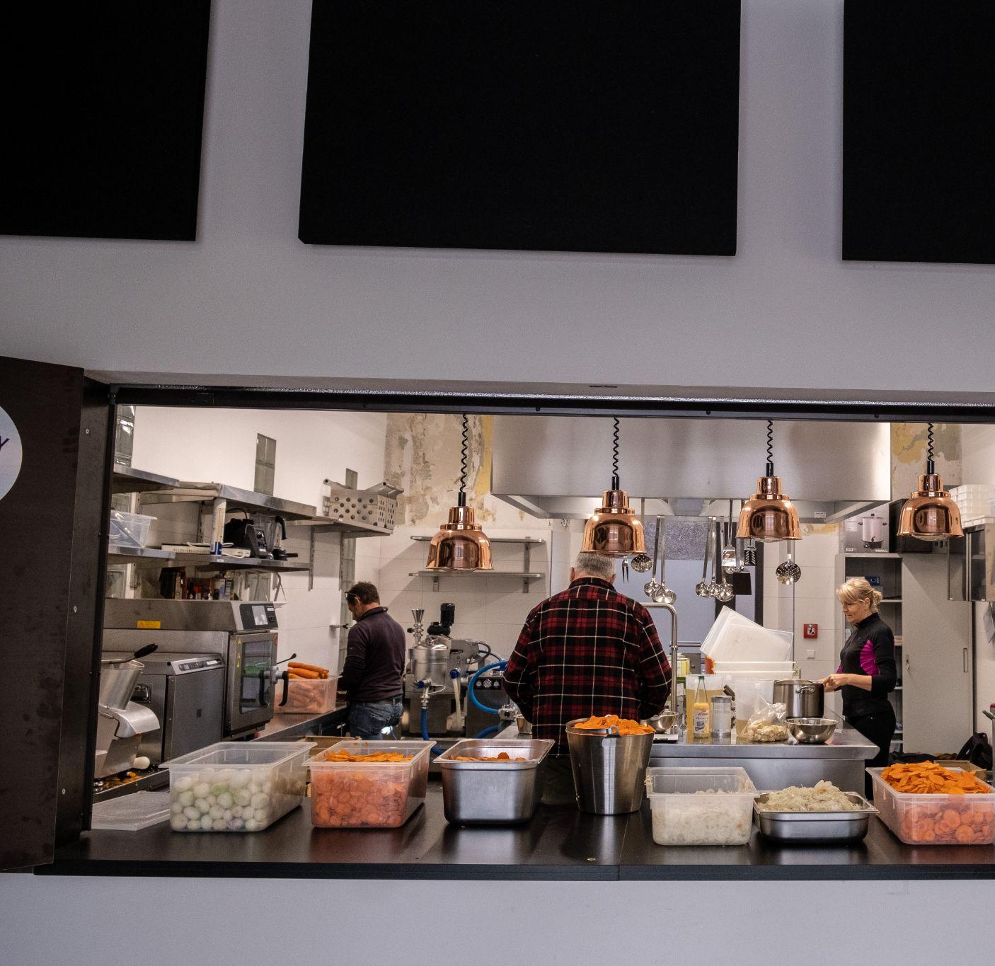
Nová Cvernovka
Communitism
Good Practices
Het Groene Veld
Bassiani
BASIS
BASIS
Critical Concrete
Rojc
Nová Cvernovka
BASIS

Slide 17

Thank you!
Contact us at [insert contact details]
[insert visualization of your space]

